Slide 1
Input Tax Credit
Availment, Restrictions, Job-work and other aspects
GSTR-1, 2 & 3
(offline utility + option of uploading data)
CA Venugopal Gella
CA Lakshmi G K

Slide 2
Objective of session
Provision and Due dates
Offline utility
How to file Form GSTR-1, 2 & 3
Issues
Options available

Slide 3
Due date for next 3 months
Return Form
Form 3B
GSTR -1
GSTR-2
GSTR-3
For July 17 (extended)
20th Aug 17
1st to 10th Sept
11th to 25th Sept
26th to 30th Sept
For August 17
20th Sept 17
01th to 5th Oct
6th to 10th Oct
11th to 15th Oct
For Sept 17
N.A.
10th Oct 17
15th Oct 17
20th Oct 17

Slide 4
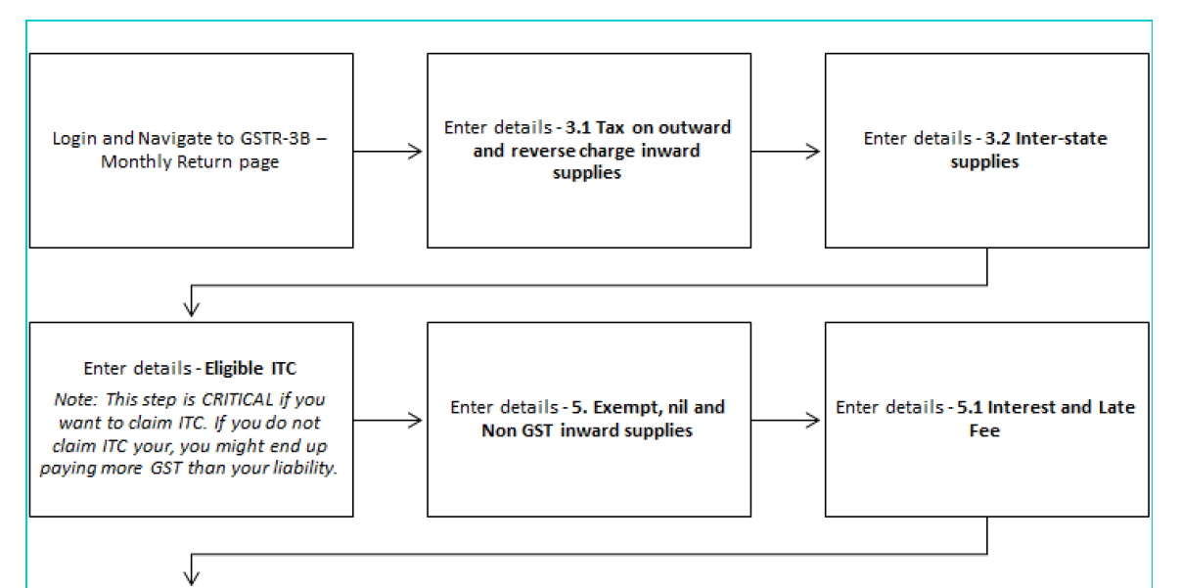
GSTR 3B – Summary

Slide 5
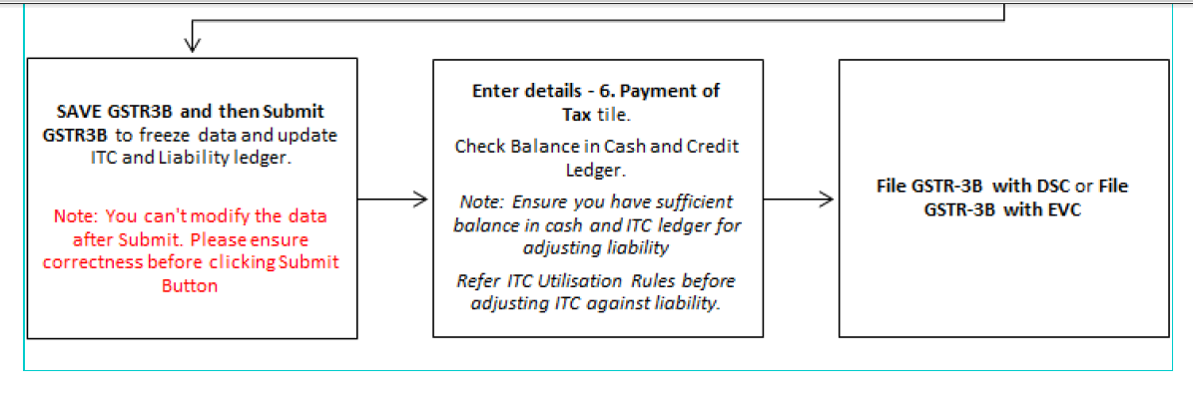
GSTR 3B – Summary

Slide 6
Reconciliation of GSTR 3B with GSTR 1, 2 & 3
After submission of GSTR 1, 2 & 2
Part A of table 12 of the GSTR-3 would get auto populated based on the information furnished in GSTR-1 & 2
Part B table 12 of the GSTR-3 shall show the revised figures of output tax liability in column (2); and
Column (3) to (7) shows the actual amount paid through GSTR-3B in cash / credit ledger
If column (2) and (3) to (7) is same – then sign and submit the return – no modification.
Particulars | Amounts disclosed in GSTR-3B | Actual amounts | Rectification
Increase in outward supplies Decrease in outward supplies | Rs. 90,000/- Rs. 1,00,000/- | Rs. 1,00,000/- Rs. 80,000/- | Rectify the same while filing GSTR-1
Increase in ITC Decrease in ITC | Rs. 1,00,000/- Rs. 90,000/- | Rs. 1,20,000/- Rs.70,000/- | Rectify the same while filing GSTR-2
The changes made in GSTR-1, 2 would auto reflected in GSTR-3 for that particular month

Slide 7
Reconciliation of GSTR 3B with GSTR 1, 2 & 3
Particulars | Amts disclosed in GSTR-3B | Actual amounts | How to Rectification
Increase in outward supplies Decrease in outward supplies | Rs. 90,000/- Rs. 1,00,000/- | Rs. 1,00,000/- Rs. 80,000/- | If column (2) is more than – 3B – pay through cash / credit ledger + interest. Carry forwarded and to be set off against the output liability of next month
Increase in ITC Decrease in ITC | Rs. 1,00,000/- Rs. 90,000/- | Rs. 1,20,000/- Rs.70,000/- | Shall be credited to credit register. Excess availed ITC would be added to output tax liability and shall be paid +interest.
Interest to be computed from 26th of Aug to till the date of debit in cash/credit ledger
If there is increase in ITC and also increase in output tax liability – increased ITC can be used for payment of increased liability.
If there is reduction in output liability and decrease in ITC – shall be adjusted and balance to be carry forwarded.

Slide 8
Reconciliation of GSTR 3B with GSTR 1, 2 & 3
If GSTR-3B is submitted but payment is not made – still the 3B would be reconciled with GSTR – 1,
The GSTR-3 would be submitted after payment of tax with interest (starts from 26th Aug)
However no late fee as per 28/2017-CT notification.
If GSTR-3B not filed, still GSTR-1, 2 & 3 need to be filed and payment with interest

Slide 9
Reconciliation of GSTR 3B with GSTR 1, 2 & 3
Late fee is waived only for July 2017 return
Interest will continue till the date of debit in respective ledgers
Valid return – full payment of tax shown in GSTR-3
Valid return to be filed for matching.
After submission of GSTR-1, 2 & 3 – matching under 41, 42 & 43 will be carried
Any discrepancy actions under section 37 & 38 will be taken care

Slide 10
Process of Filing Return
GSTR-1
Upload details of outward supply on 10th of subsequent month
GSTR-2A
Make additions, modifications and deletions from 11th to 15th -5 options – Accept, Reject, Modify, Add, Do nothing
GSTR-2
Additions, modifications and deletions by recipient will be made available to supplier and submitted on 15th
GSTR-1A
Corrections in Form GSTR-2 will be made available to supplier
Data will be auto populated
Supplier has to accept or reject adjustments by 17th
GSTR-3
Auto-populated return will be available for submission along with the payment on 20th between 18th to 20th

Slide 11
GSTR 1 – Outward Return

Slide 12
GSTR 1 Outward Supply – Section 37
Every registered taxable person other than Composition, NRTP, OIDAR, ISD, TDS & TCS
Electronically,
On or before 10th of next month
Communicate GSTR 1 to recipient in GSTR 2A on real time basis
Recipient has five options which can be exercised between 11th to 15th
Changes will be Communicated to supplier
Supplier can either accept or reject such changes
The return filed u/s 37 shall stand amended to the extent of such acceptance or rejection.
If the details filed remains unmatched u/s 42 or 43, shall be rectified upon discovery of any such errors or omissions:
No rectification after Fling of annual return or furnishing return for the month of September of the next year WIE
If not rectified, pay tax and interest, if any, in case of any short payment of tax on account of such error or omission.

Slide 13
GSTR 1 Outward Supply – Section 37
In case of extension of date – GSTR 3B needs to be filed.
GSTR-1 need to be even though no business during the tax period
GSTR-1 can be prepared in online and offline
Tax payer should have active DSC for filing
One invoice – one POS
Values to be declared up to 2 decimals.
Separate invoice for RCM – to be displayed and not considered for tax liability.

Slide 14
Return offline tool
Businesses that generate a large number of invoices in a tax period may find it cumbersome to upload invoices one-by-one.
Not only that, it will become a time-consuming activity with a cost implication.
Therefore, to facilitate the upload of invoices in bulk, Goods and Service Tax Network (GSTN) provides Returns Offline tool for Returns in which a taxpayer can add up to 19,000 line items in the offline mode and upload them in one go.
In case a taxpayer has more invoice data, they can use the Returns Offline tool multiple times to upload the same
System Requirement
Windows OS 7.0 and above
Microsoft Office Excel 2007 and above, if you plan to use Excel to enter data first and then import the same in the Tool. If you can import data in csv format from another accounting software, as given along with Tool in the Zip file of Tool, you do NOT need Excel.
It is highly recommended that Internet Explorer 10+ is installed on your system.

Slide 15
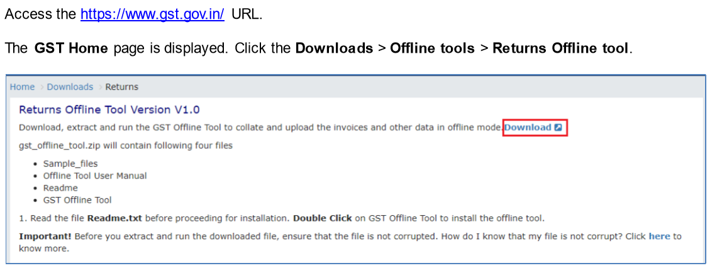
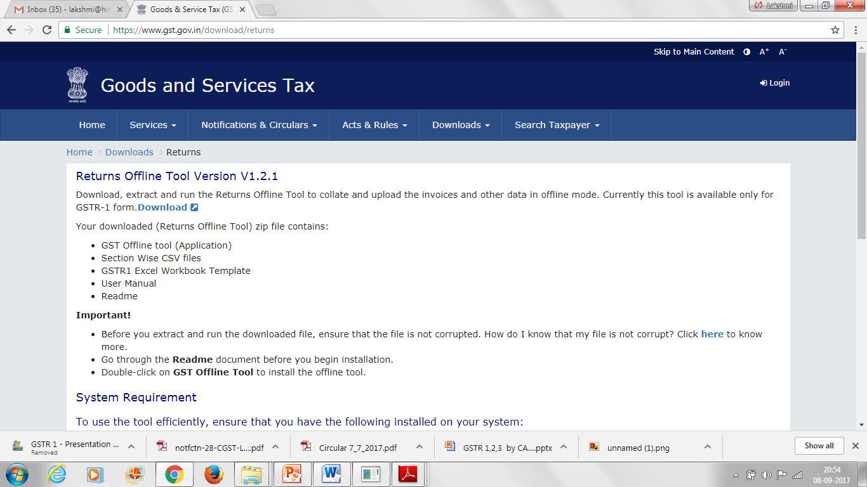
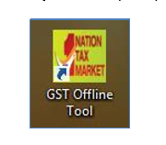
Return offline tool – Download & install

Slide 16
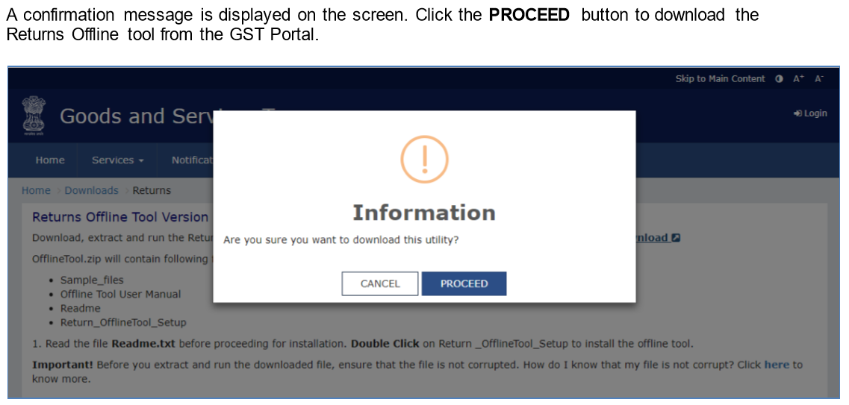
Return offline tool – Download & install

Slide 17
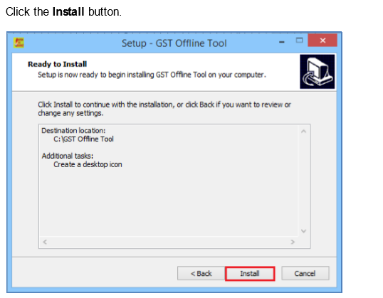
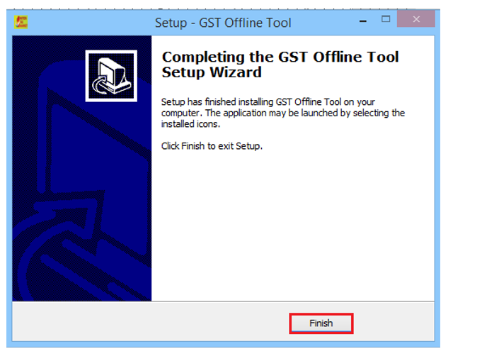
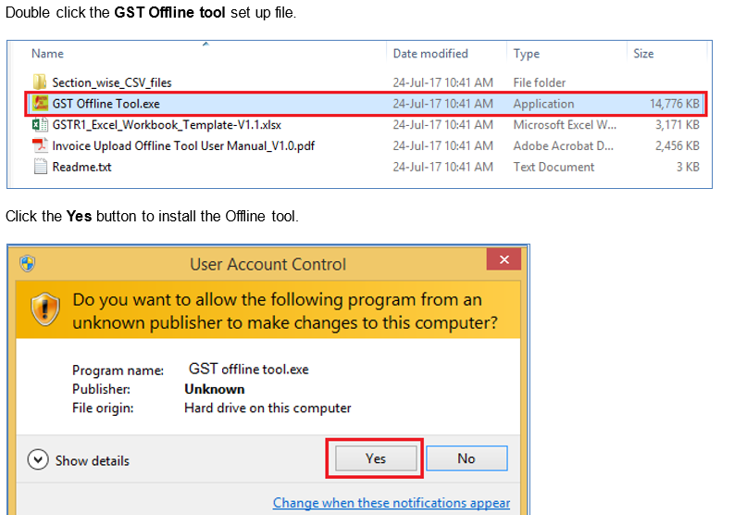
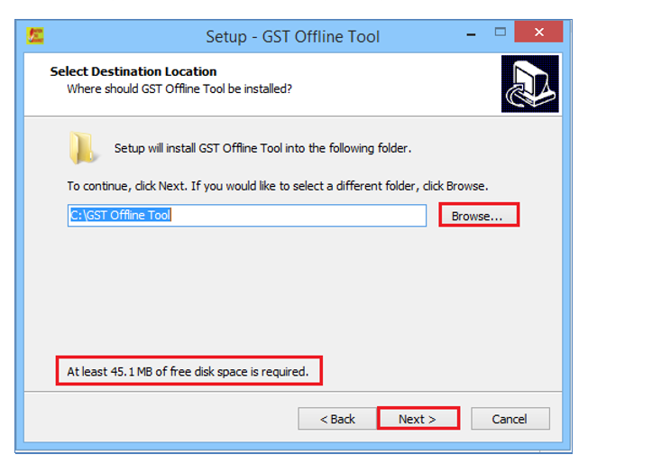
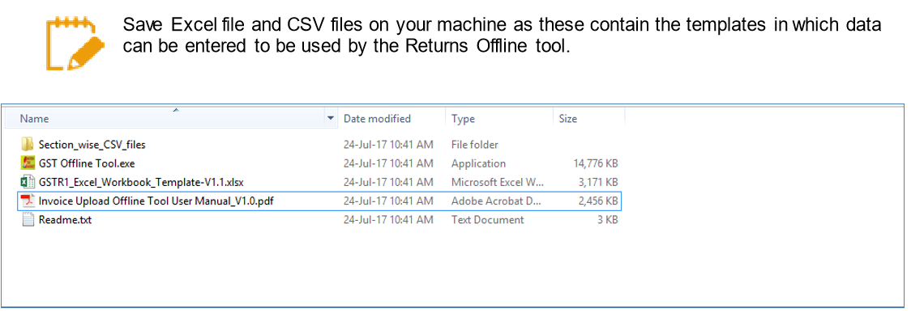
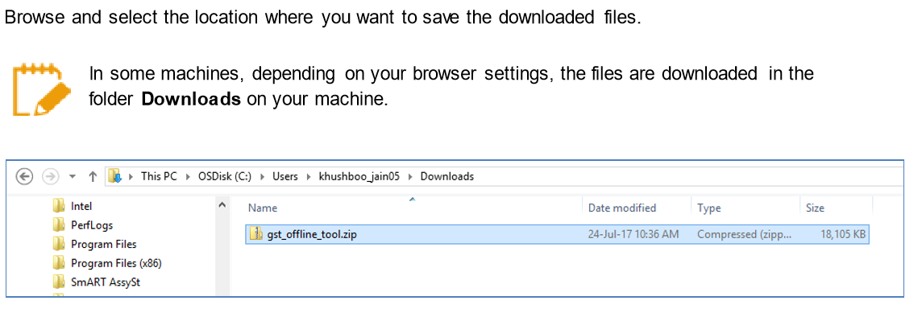
Return offline tool – Download & install

Slide 18
Return offline tool – Uploading of Invoice data
1
2
3
4
Manual Entry of Invoice data
Import all sections Excel Workbook consisting of multiple work sheets
Copy and Paste from excel work book
Import the .csv files

Slide 19
Option 1: Manual entry of Invoice Data

Slide 20
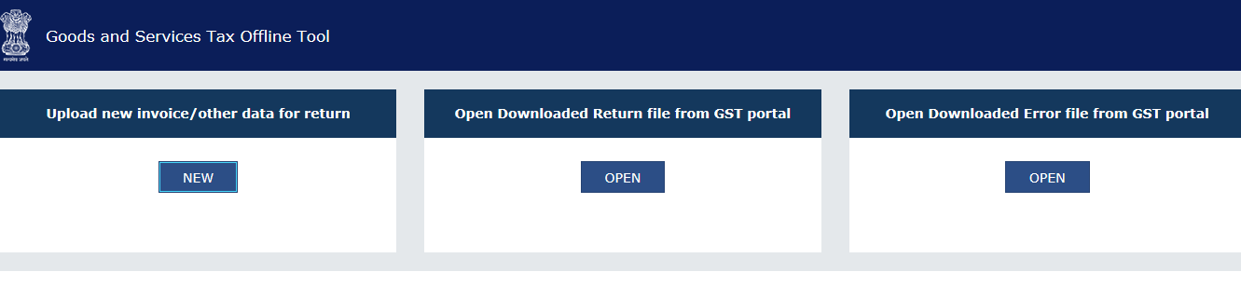
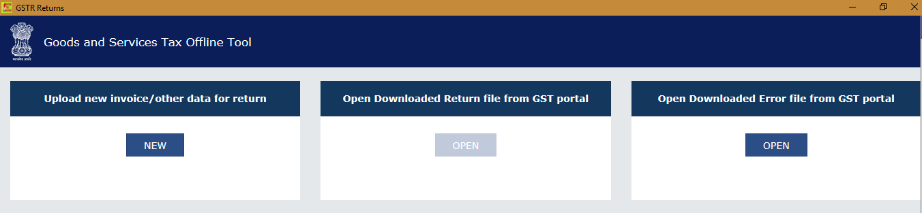
Option 1: Manual entry of Invoice Data
Upload new invoice/ other data for return:
The NEW button is used to Upload New Invoice/ upload other data. (Return will be prepared on the GST Portal based on the data uploaded using the tool. One can upload invoice data as many times as one wants.)
Open Downloaded Return file from GST portal:
The OPEN button is used to open Downloaded pre-auto populated Return file (like GSTR-1, 1A, 2A..etc) which was downloaded from GST Portal.
Open Downloaded ERROR File from GST portal:
The OPEN button is used to open error file to understand the errors occurred on the portal while uploading the JSON file to the portal and take necessary action to rectify the invoices rejected by GST Porta

Slide 21
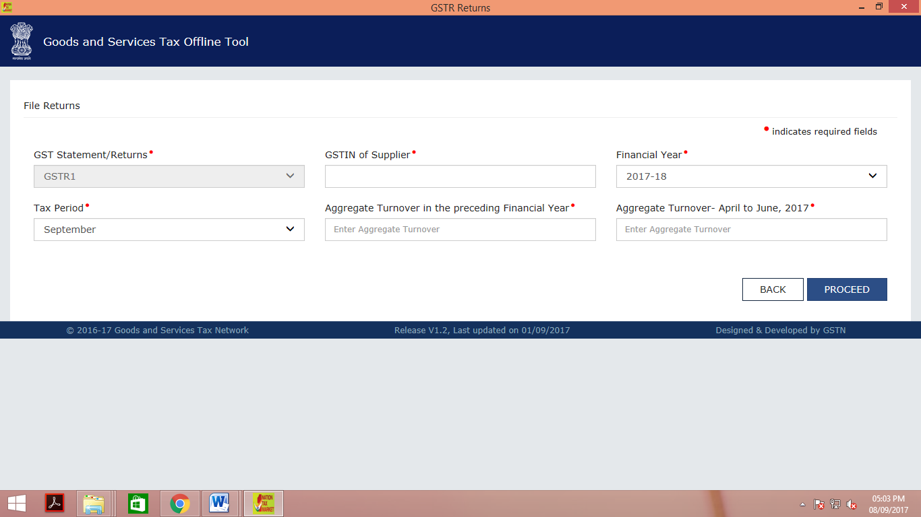
Return offline tool – Logging into offline tool

Slide 22
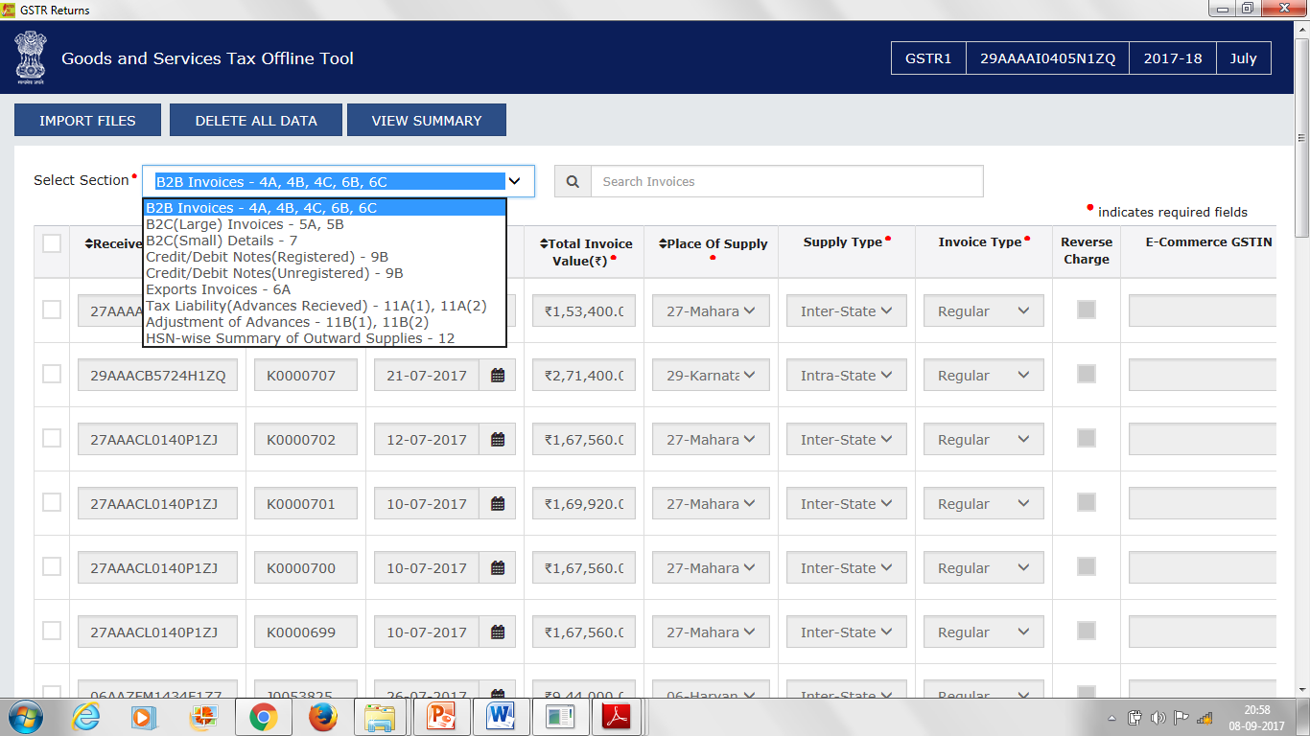
Return offline tool – Logging into offline tool

Slide 23
Option 2: Upload from excel sheet

Slide 24
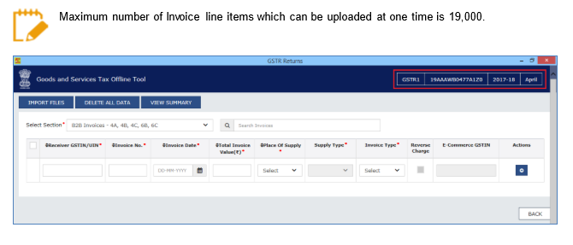
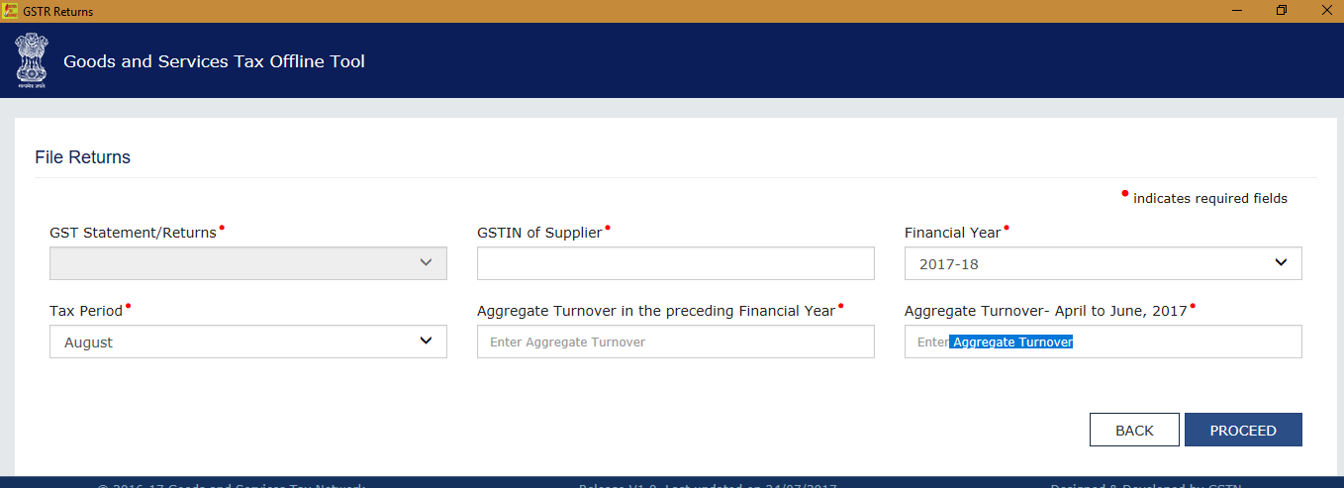
Return offline tool – Manual Entry

Slide 25
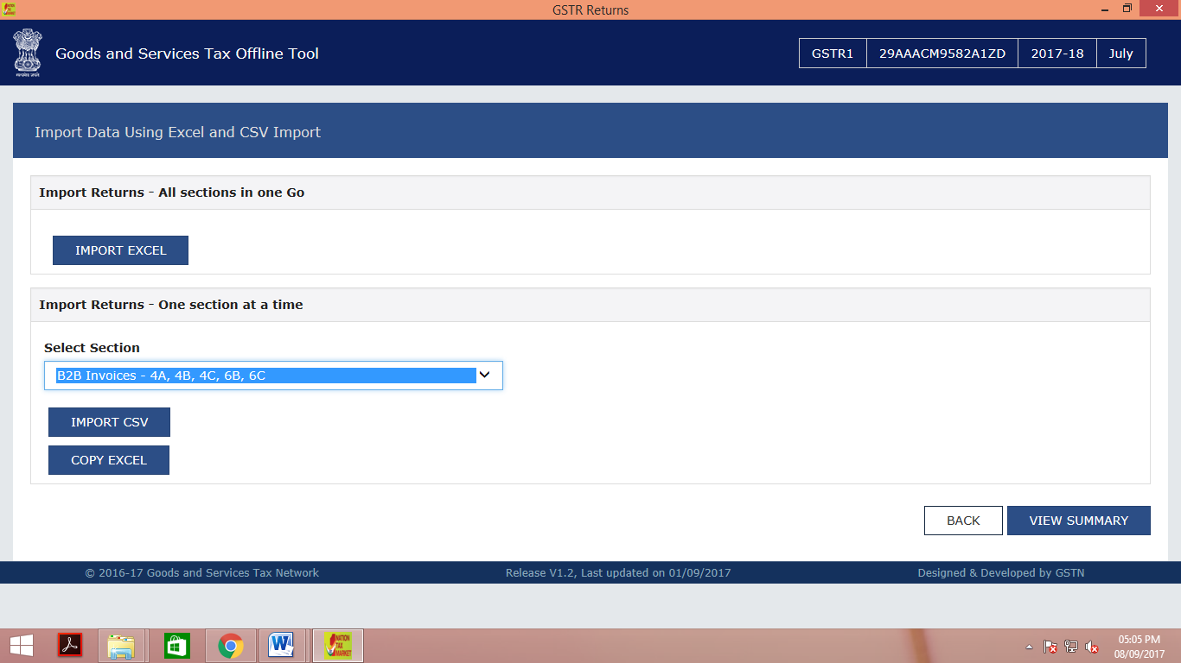
Return offline tool – using the excel sheet provided

Slide 26
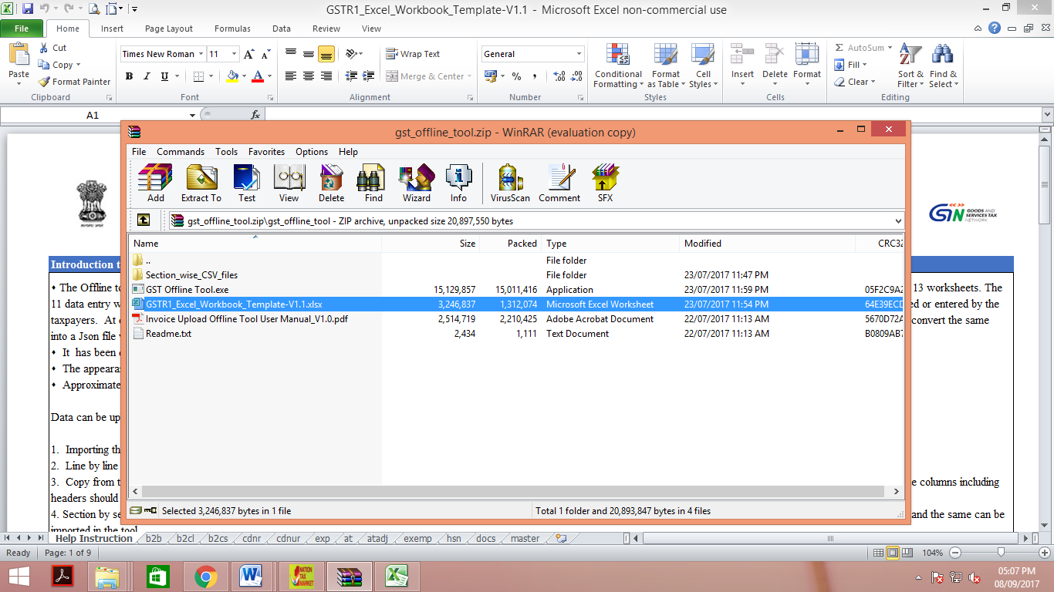
Return offline tool – using the excel sheet provided

Slide 27
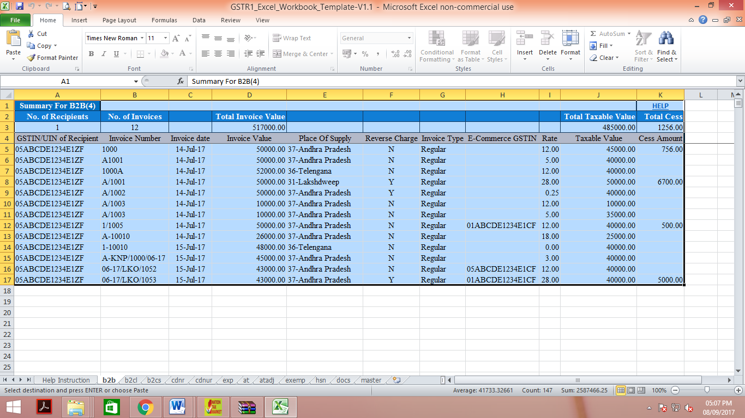
Return offline tool – using the excel sheet provided

Slide 28
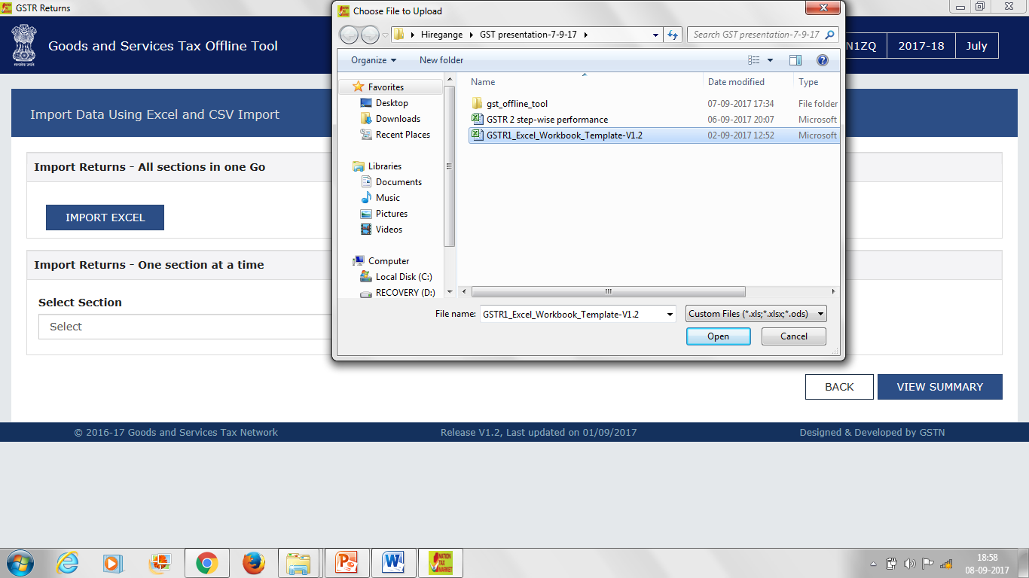
Return offline tool – using the excel sheet provided

Slide 29
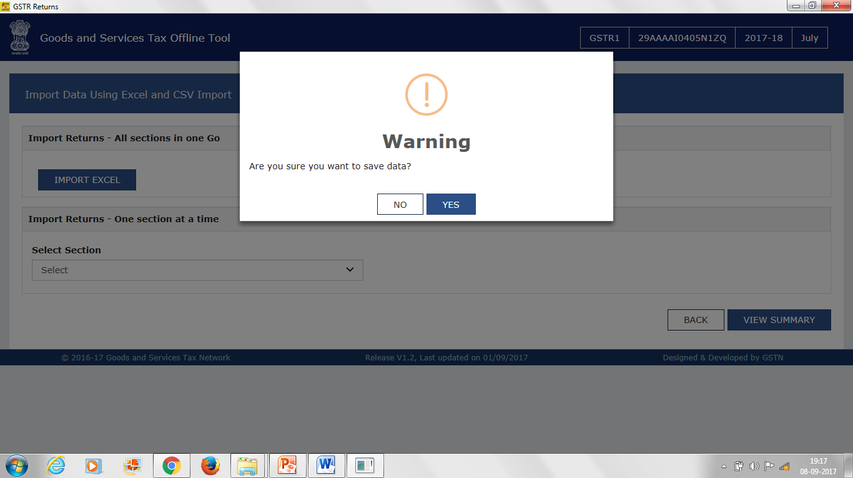
Return offline tool – using the excel sheet provided

Slide 30
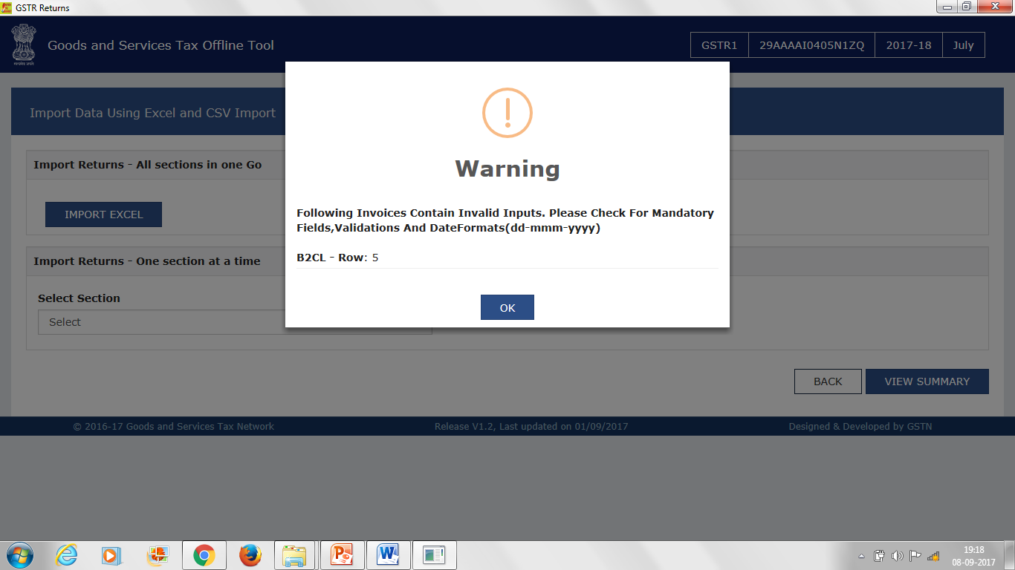
Return offline tool – using the excel sheet provided

Slide 31
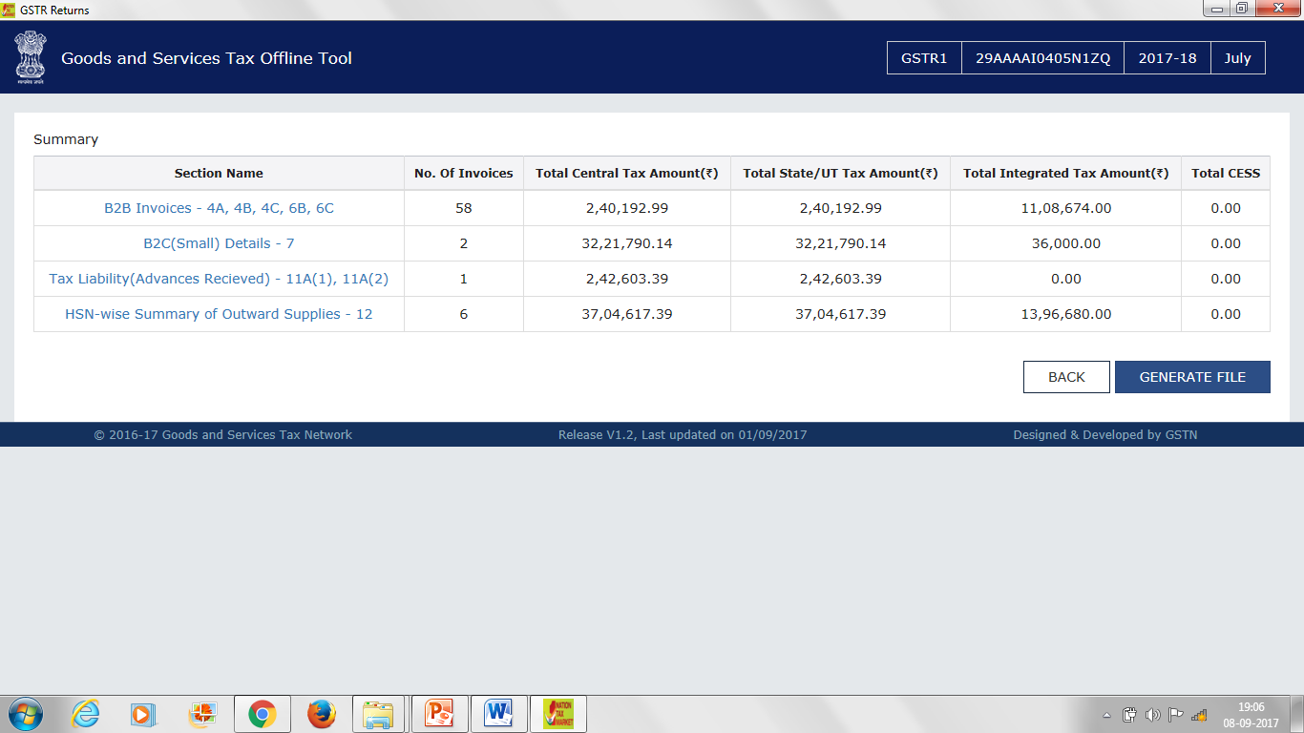
Return offline tool – using the excel sheet provided

Slide 32
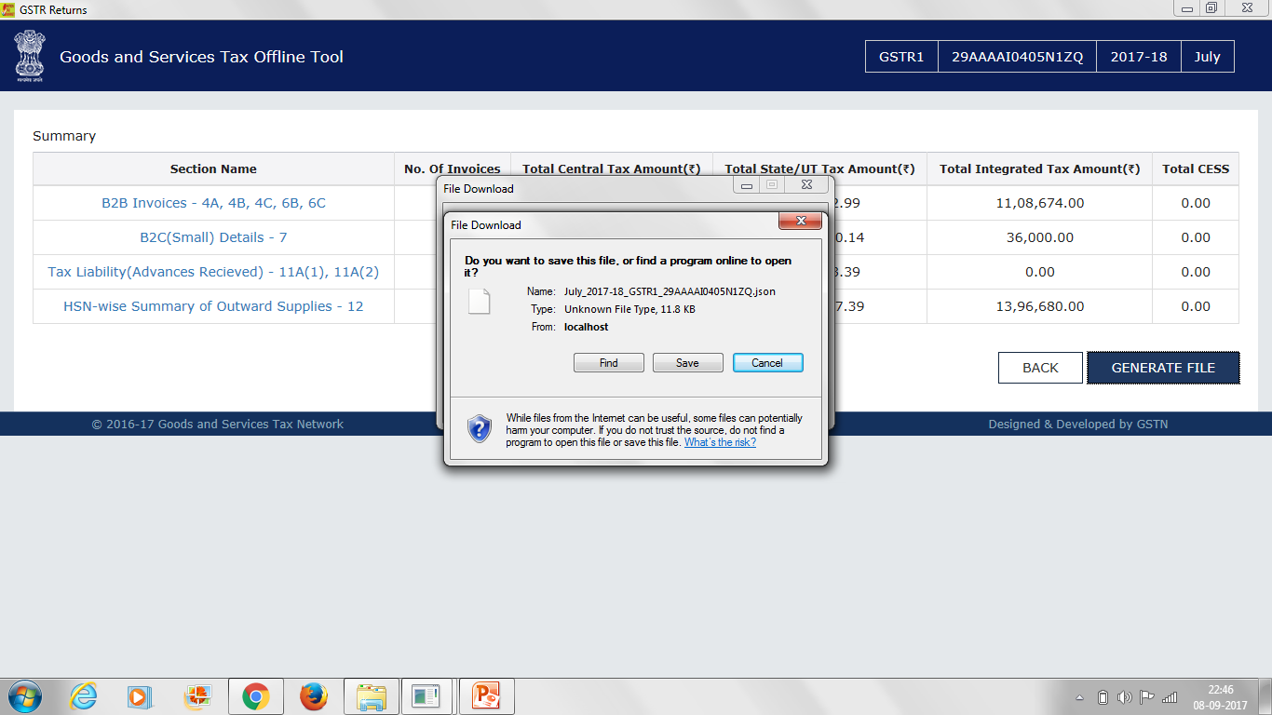
Return offline tool – using the excel sheet provided

Slide 33
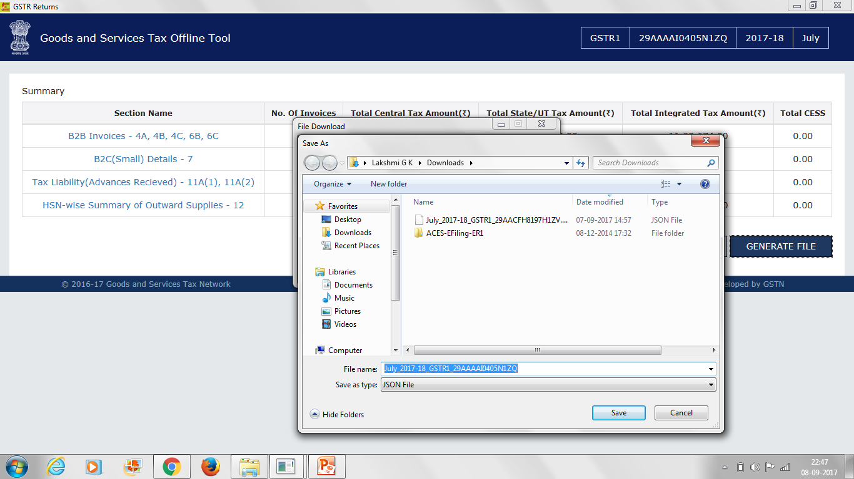
Return offline tool – using the excel sheet provided

Slide 34
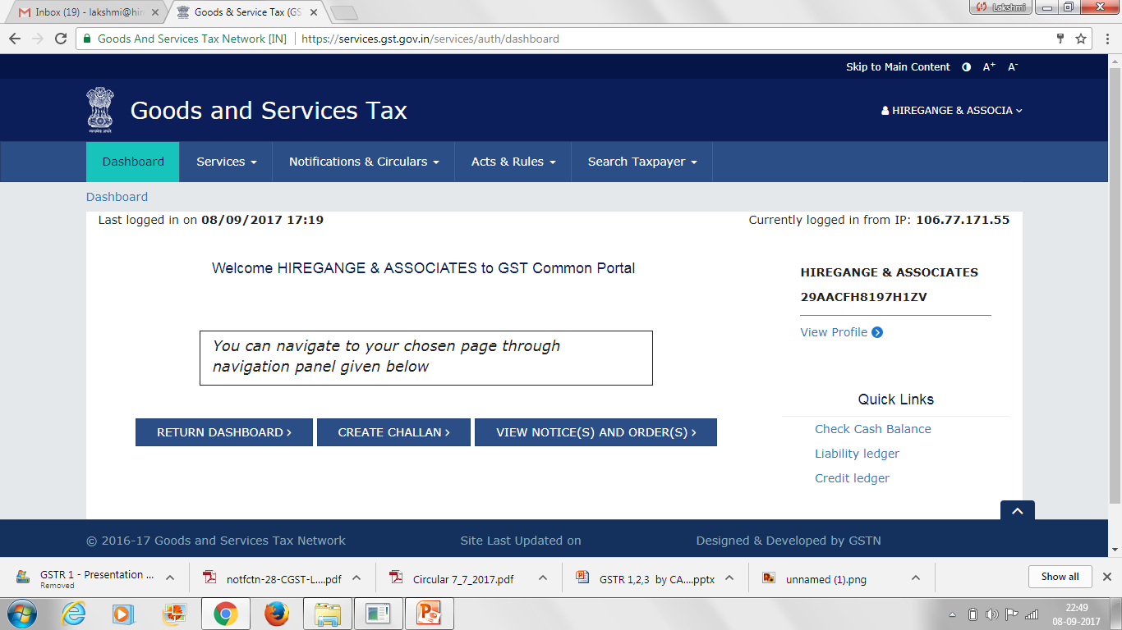
Return offline tool – using the excel sheet provided

Slide 35
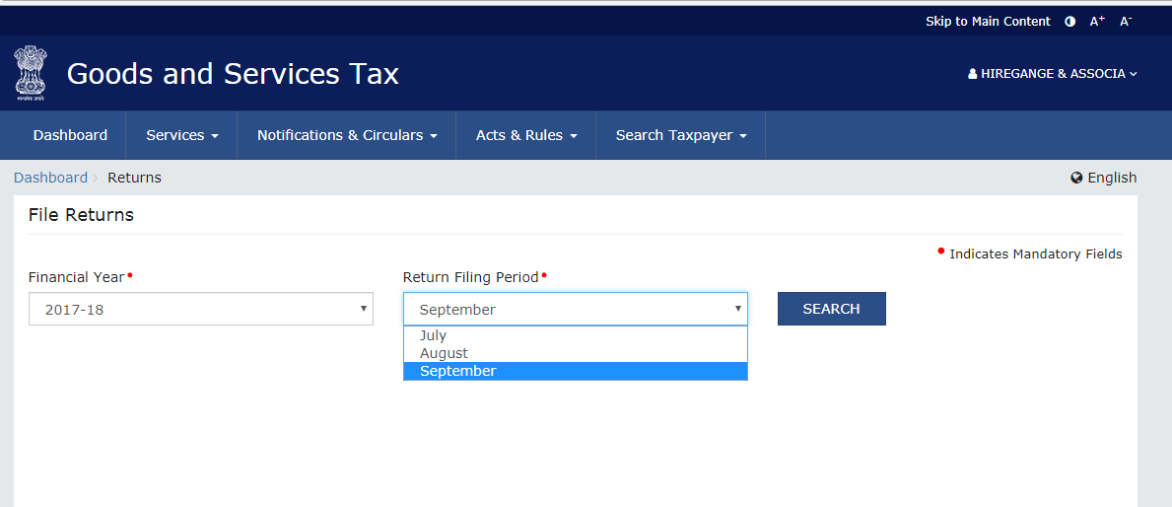
Return offline tool – using the excel sheet provided

Slide 36
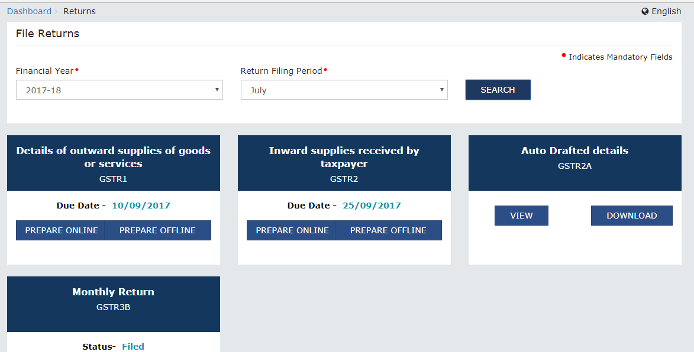
Return offline tool – using the excel sheet provided

Slide 37
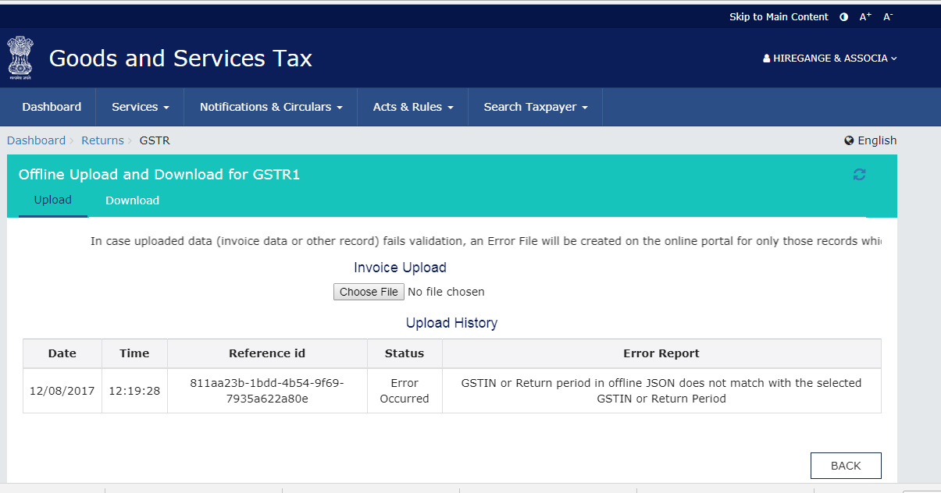
Return offline tool – using the excel sheet provided

Slide 38
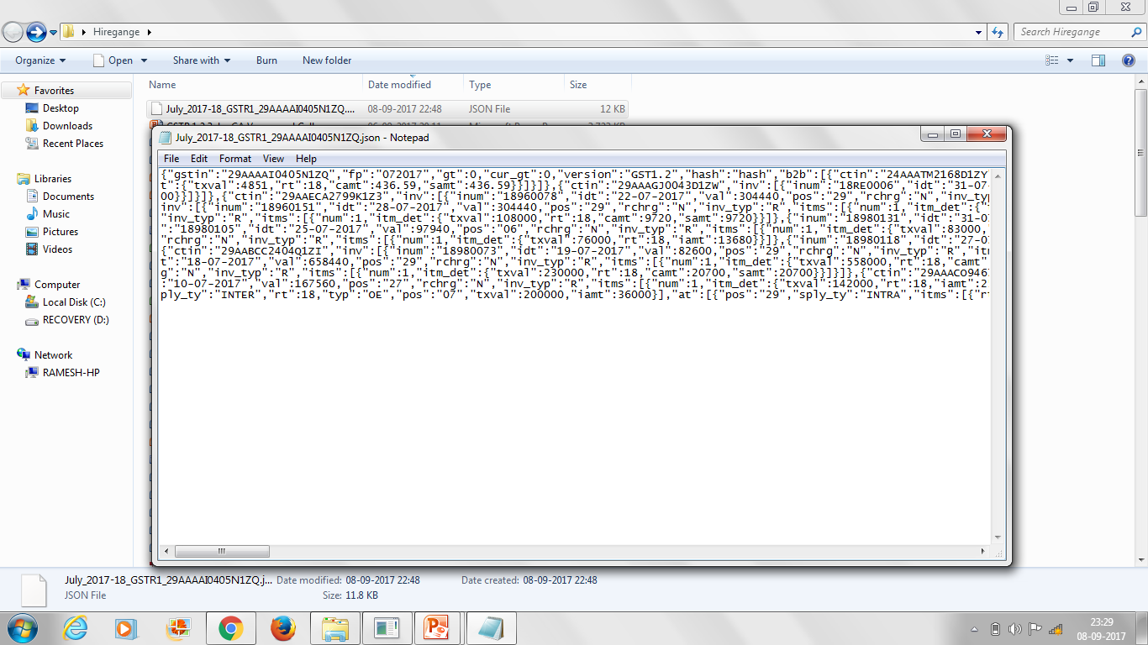
Return offline tool – JSON file cannot be read

Slide 39
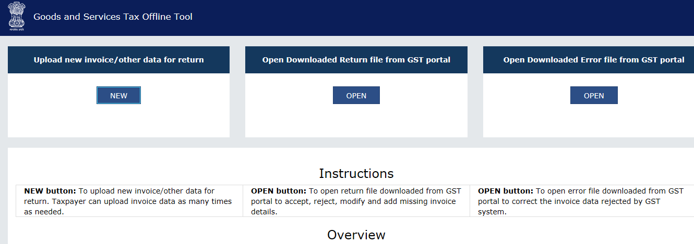
Return offline tool – Error report – JSON file

Slide 40
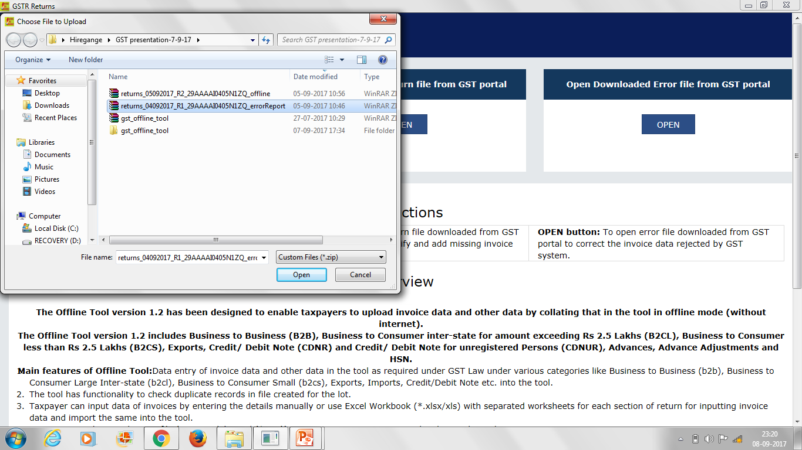
Return offline tool – Error report – JSON file

Slide 41
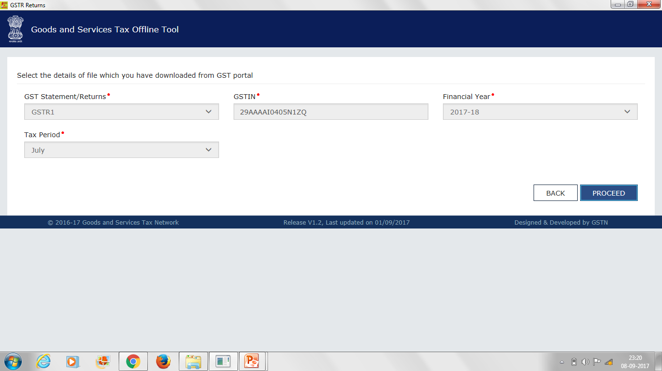
Return offline tool – Error report – JSON file

Slide 42
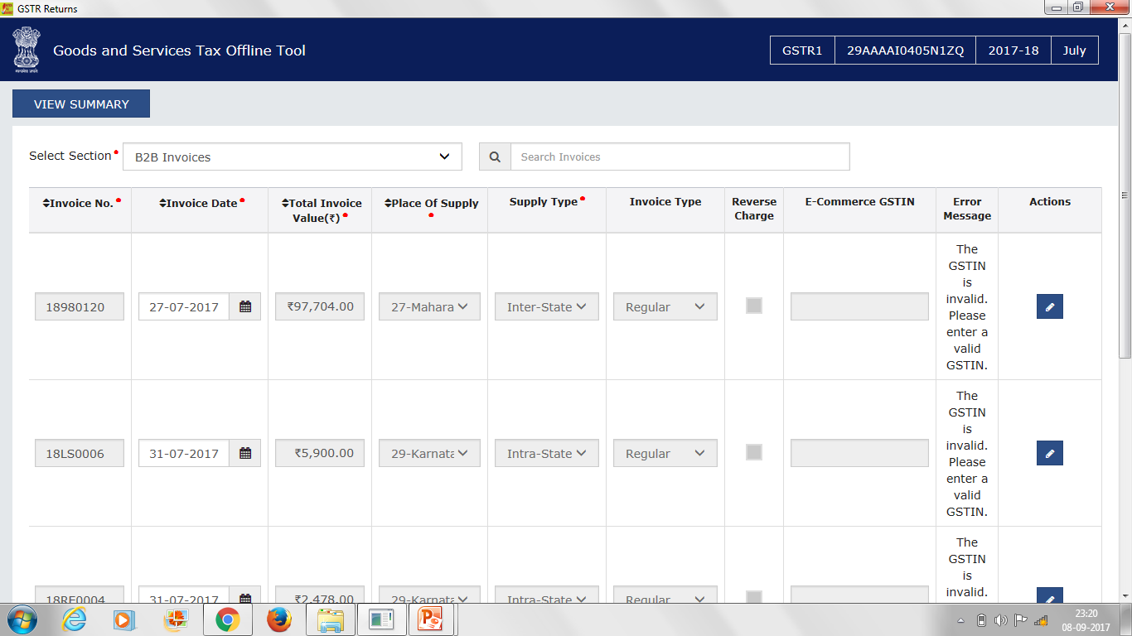
Return offline tool – Error report – JSON file

Slide 43
Option 3: Copy paste from excel

Slide 44
Return offline tool – Copy paste from excel sheet

Slide 45
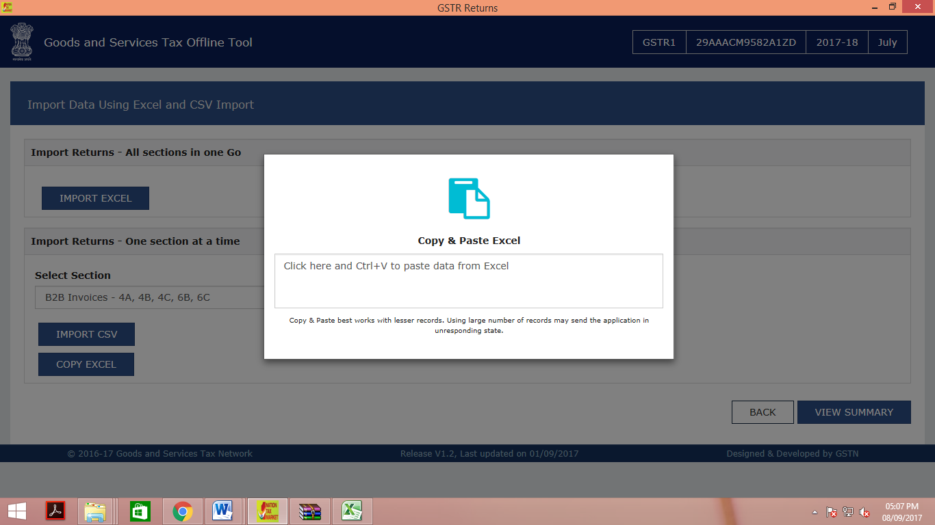
Return offline tool – Copy paste from excel sheet

Slide 46
Option 4: Upload csv file

Slide 47
Return offline tool – upload csv file

Slide 48
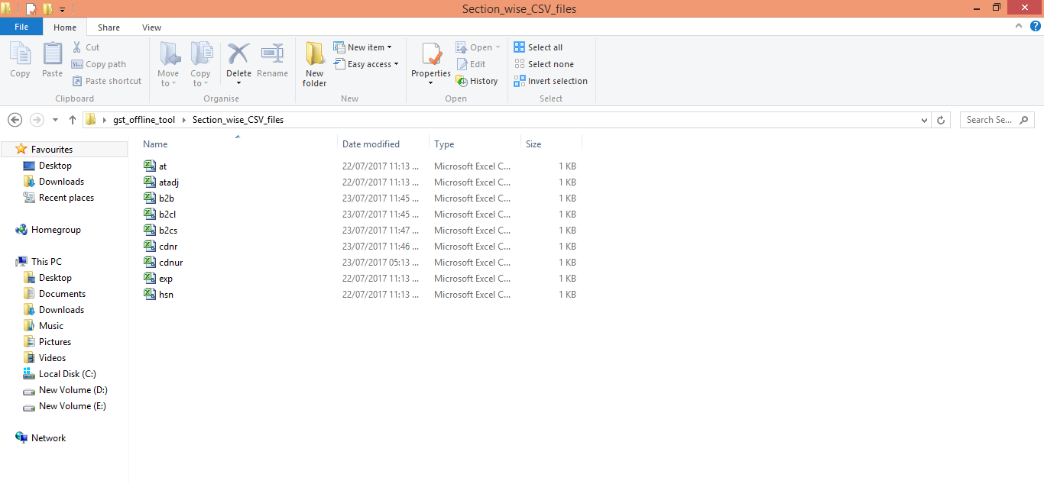
Return offline tool – upload csv file

Slide 49
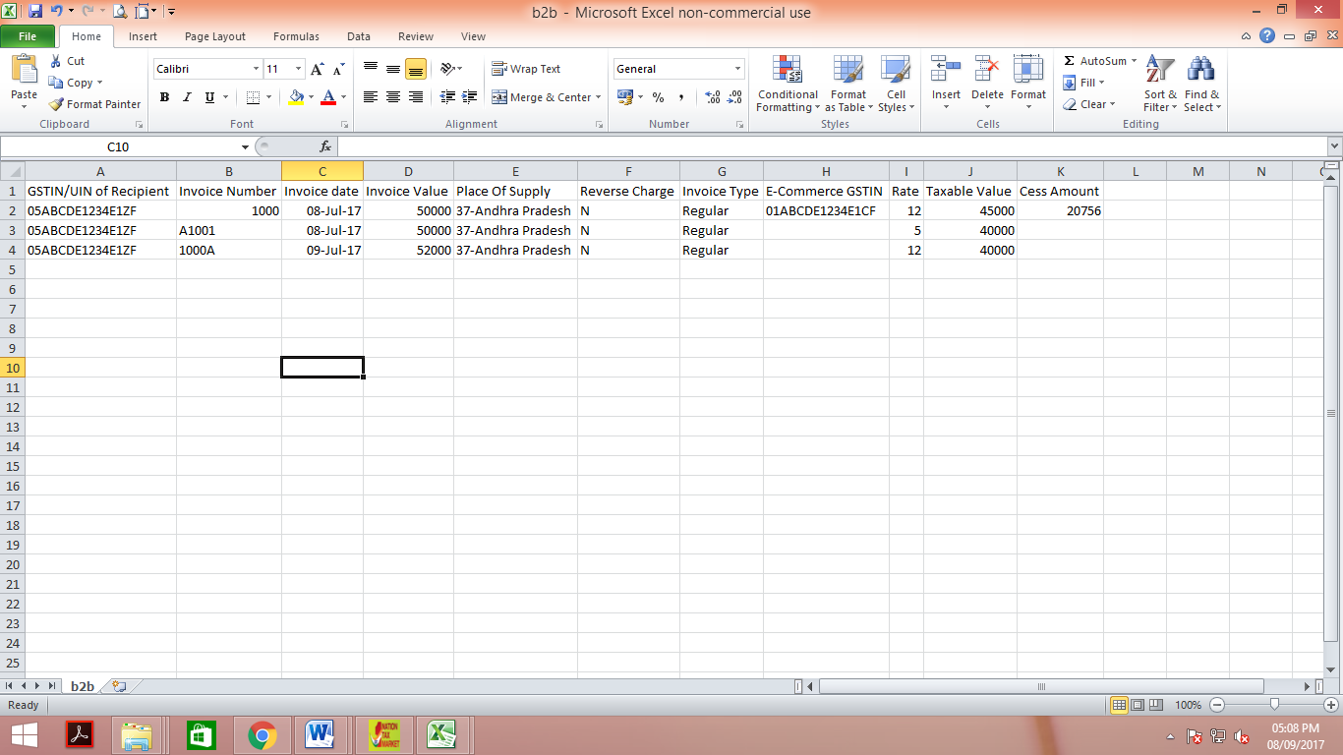
Return offline tool – upload csv file

Slide 50
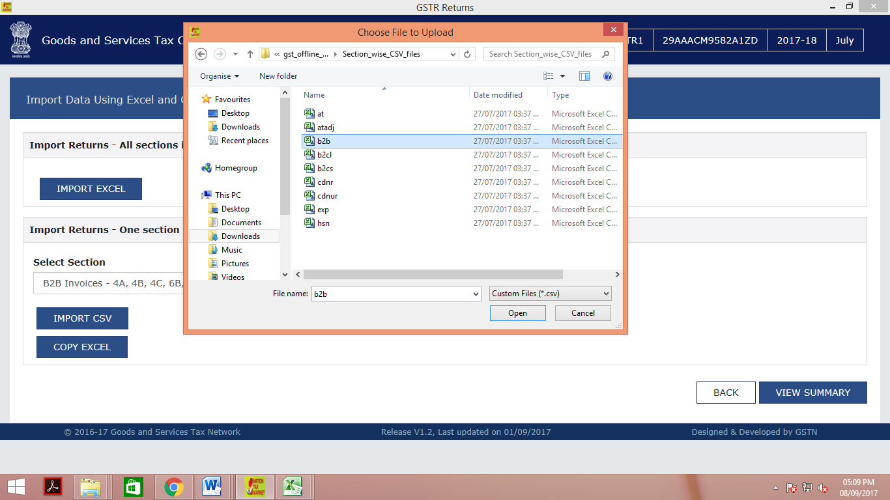
Return offline tool – upload csv file

Slide 51
Return offline tool – upload csv file
All other procedures would be same.
However w.r.t copy paste from excel and uploading csv file - to be down table by table basis

Slide 52
GSTR-1

Slide 53
Turnover Categorization
  Level of detailing
    Invoice wise
    Consolidated
  Destination Based
    Inter State Supplies – IGST
    Intra State Supplies – CGST + SGST
  Medium of Sales
    E-Commerce Platform
    Other than E-commerce platform
  Reverse Charge
    Registered but Reverse Charge Supplies
    Forward Charge Supplies
  Taxation Based
    Taxable Supplies
    Exempt Supplies
  Customer Based
    Registered Person Supplies (B2B)
    Unregistered Person Supplies (B2C)
  B2C
    B2C large invoices (invoice value higher than 2.5 Lakhs – Inter state)
    B2C Others
Notes:
Any changes in the earlier records to be tracked additionally, since no revised returns

Slide 54
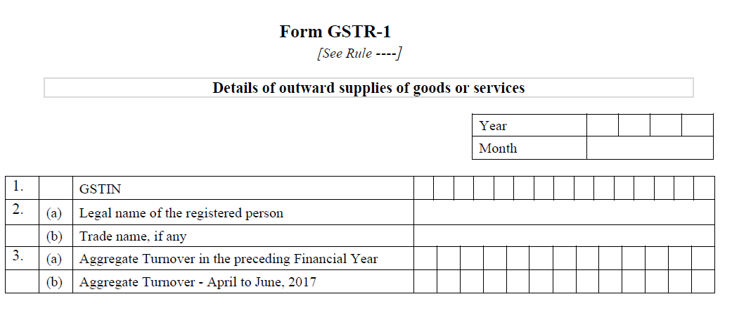

GSTR 1 – Table 1 to 3
Turnover information would be required only in the first year.
Quarterly turnover information shall not be captured in subsequent returns.
Aggregate turnover shall be auto-populated in subsequent years – based on all the annual returns filed for GSTINs with a given PAN.

Slide 55
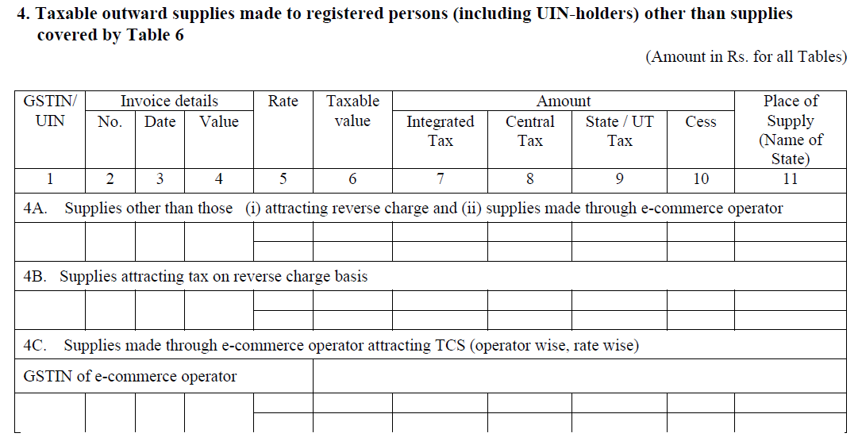
GSTR 1 – Table 4

Slide 56
GSTR 1 – Table 4
Invoice value – value inclusive of taxes
Taxable value – As per GST
B2B – includes supplies attracting RCM in the hands of recipient
Supply made by SEZ to DTA – to be disclosed in GSTR-2 by DTA.
If no BOE – SEZ to show in GSTR-1
If any invoice is not uploaded – upload in Aug …..

Slide 57
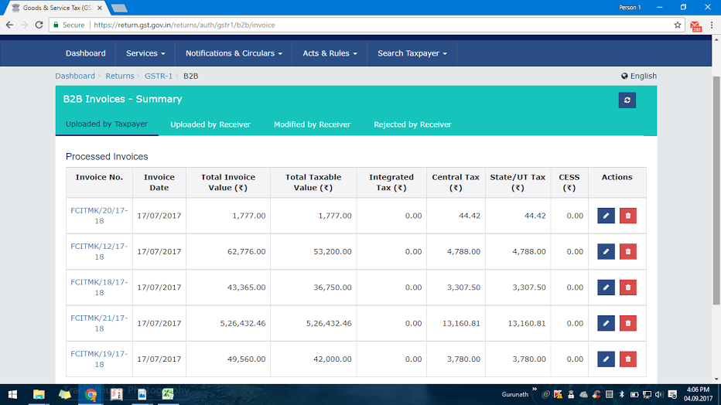
GSTR 1 – Table 4 – RCM entry by supplier
5 invoices
Sec 9(3)

Slide 58
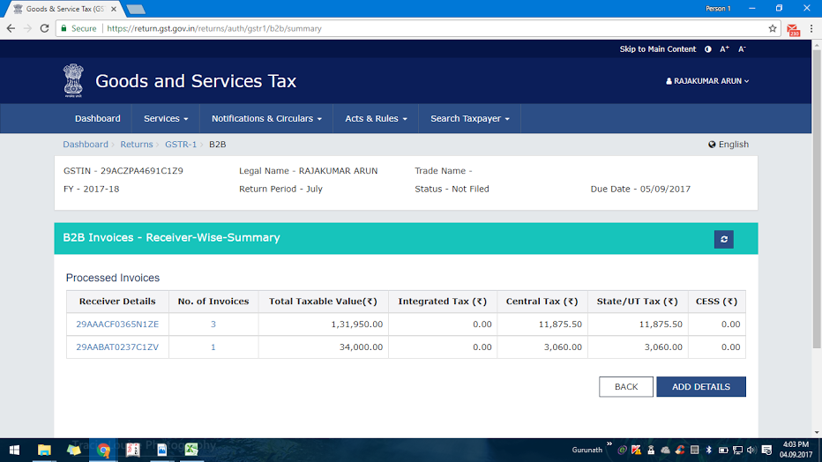
GSTR 1 – Table 4 – RCM entry by supplier
4 invoices

Slide 59
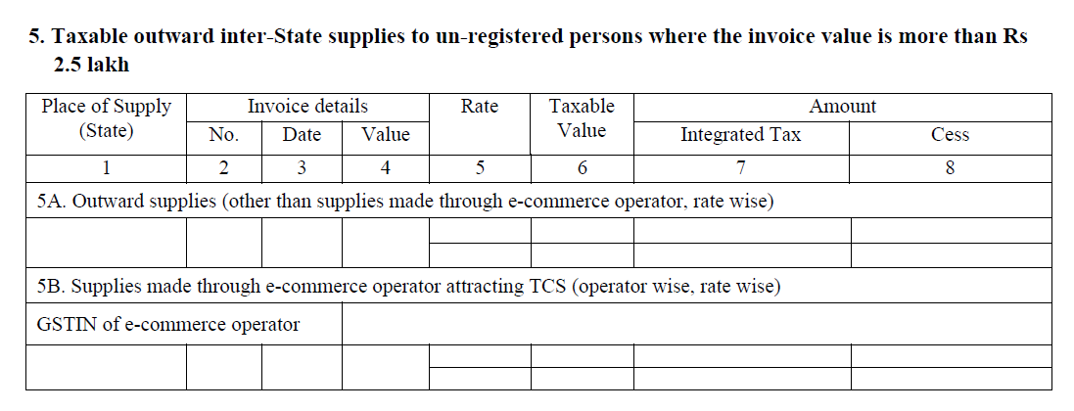
GSTR 1 – Table 5 - B2C > 2.5

Slide 60
GSTR 1 – Table 5 - B2C > 2.5
Only B2C inter-state transaction exceeding 2.5Lakh
Q – If within the state there is a transaction > 2.5 Lakh do I need to reflect here ? –
The answer is No –Its specific for Inter state.
Invoice value = Taxable Value + Tax

Slide 61
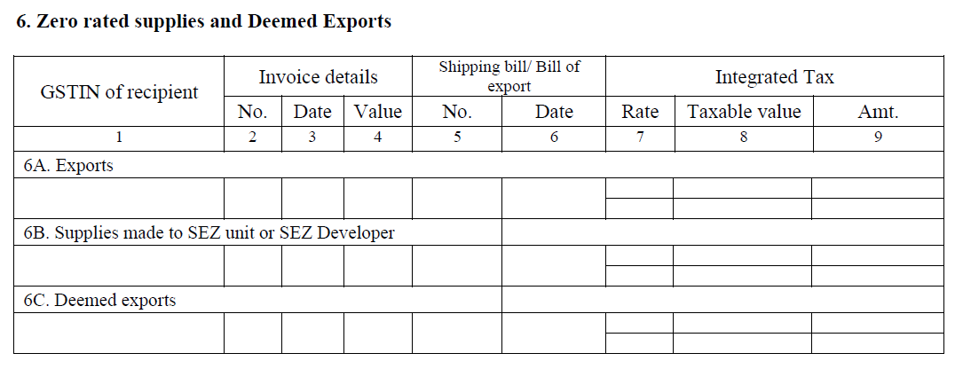
GSTR 1 – Table 6

Slide 62
GSTR 1 – Table 6
Shipping bill details are not available
Still transaction is accepted
To be submitted – by way of amendment in table 9
In case of export transaction – GSTIN of recipient required?
No
Column would be left blank
Export without payment of IGST
Select rate as “0”
Other rate only if export with IGST

Slide 63
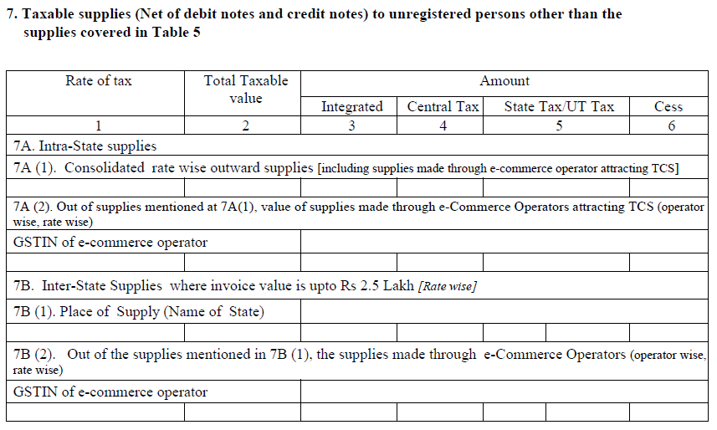
GSTR 1 – Table 7

Slide 64
Details captured..
7A. Intra-state supplies – after net off of the value of credit/debit note
    Consolidated rate wise outward supplies (including supplies made through e-commerce operator attracting TCS) after
    Out of supplies mentioned at 7A(1), value of supplies made through e-commerce operators attracting TCS (operator- wise, rate wise) including GSTIN of e-commerce operator.
  7B. Inter state supplies where invoice value is upto Rs. 2.5Lakh (rate wise)
  Place of supply (name of the state)
  Out of supplies mentioned at 7B(1), the supplies made through e-commerce operators (operator wise, rate wise) including GSTIN of e-commerce operator.

Slide 65
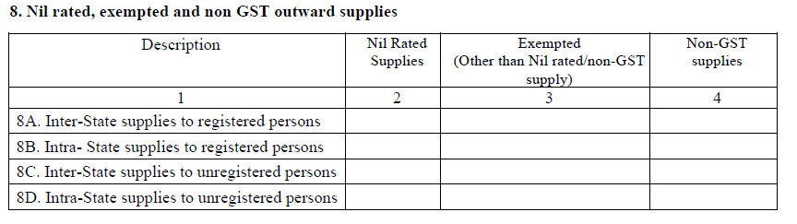
GSTR 1 – Table 8
Important Points
Separate Nil rate and exempted supply even though both has same treatment.
Non- GST Supplies like Petrolium products, alcohol,

Slide 66
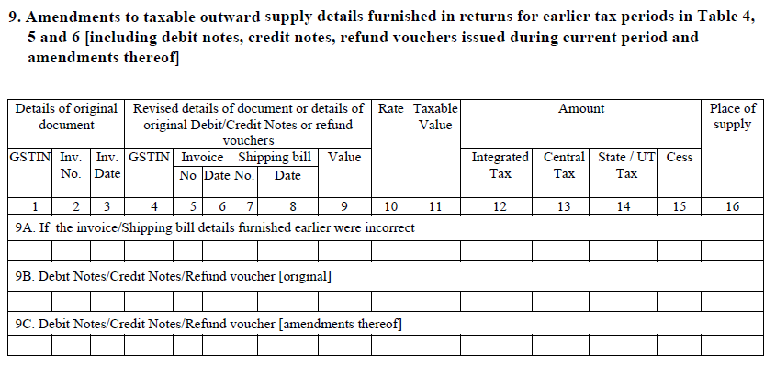
GSTR 1 – Table 9 Amendment

Slide 67
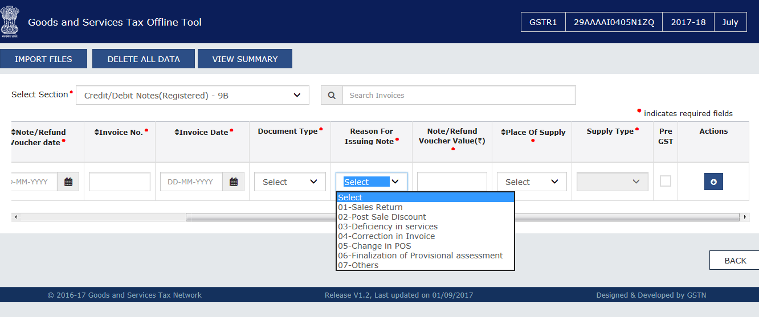
GSTR 1 – Table 9 Amendment

Slide 68

GSTR 1 – Table 9 Amendment

Slide 69
GSTR 1 – Table 9 Amendment
Amendments of B to B supplies reported in Table 4, B to C Large supplies reported in Table 5 and Supplies involving exports/ SEZ unit or SEZ developer/ deemed exports reported in Table 6;
Information to be captured rate-wise;
Shipping bill to be provided only in case of exports transactions amendment.
It also captures original information of debit / credit note issued and amendment to it reported in earlier tax periods

Slide 70
GSTR 1 – Table 9 Amendment
Debit Notes are to be reported in the return of the month in which they are issued by the supplier.
Credit Notes are to be reported in the return of the month in which they are issued but not later than the return of the September month following the end of the financial year in which such supply was made, or the date of furnishing of the relevant annual return, whichever is earlier.
EX: I have raised invoice – Rs.1,00,000/- with rate 12% instead of 18% - can debit note be raised.

Slide 71

GSTR 1 – Table 10

Slide 72

GSTR 1 – Table 11

Slide 73
Details captured..
Important Points
11A captures advances received, rate-wise, in the tax period and tax to be paid thereon along with the respective PoS.
11B - for adjustment of tax paid on advance received and reported in earlier tax periods against invoices issued in the current tax period.
Advance info – Not required if invoice is also raised in the same month.

Slide 74
Details captured..
Initially tax paid under advance amount under IGST.
However invoice raised C+S
The tax paid IGST – hence set off against IGST of other liability
Further C+S need to be paid.

Slide 75

GSTR 1 – Table 12 (Mandatory)
HSN, If Annual Turnover for previous year
Upto 1.5 Crore
1.5 Cr. To 5 Cr
More than 5 Cr.
Optional
2 Digit
4 Digit

Slide 76

GSTR 1 – Table 13

Slide 77
GSTR 2 – Inward Return
Most of the information is auto-populated

Slide 78
GSTR-2
The details of outward supplies uploaded in GSTR-1 by the supplier would be auto-populated in GSTR-2A on real time basis.
The recipient taxpayer has option to:-
  Accept
  Reject,
  Modify (If information provided by the supplier is not correct)
  Keep the transaction pending for action (if goods or services have not been received); or
  Add the inward transactions which are not uploaded by the supplier (possess the invoice + received goods or services).
No such modification shall be allowed after filing return for September of the next year or filing of annual return.

Slide 79
GSTR-2
The modifications or additions made by the recipient would be communicated to supplier in GSTR-1A.
The supplier has to accept such modifications or reject on 16th and 17th of subsequent month.
The changes accepted by the supplier would amend the GSTR-1 automatically.
GSTR-2 - To file before 15th of subsequent month
Transactions to be classified as (T1,T2,T3 & T4) – for availment of credit.
With respect to RCM – time of supply need to be seen as per section 12 and 13

Slide 80
GSTR-2 – Steps to be taken care
Before logging into portal clear browsing history (Ctrl+Shift+Delete) / Ctrl + F5
Link on refresh button to get real time data validation (presently challenges are faced in GSTR-1)
Download GSTR-2A from common portal – on or after 11th of subsequent month (A), though available on real time basis
Keep the purchase register ready to compare the data with GSTR-2A downloaded (B) (GSTIN wise)
Match (A) and (B)

Slide 81
GSTR-2 – Steps to be taken care
Possible errors on matching would be:
  Mismatch with invoice details – tax amount – modify the same
  Goods not received, invoice uploaded by the supplier – goods in transit – keep the transaction under pending action.
  In possession of invoice but not uploaded by the supplier – Add manually – follow up vendor – if mismatch – more than 2 months – interest liability
  Invoice updated by the supplier wrongly in your GSTIN – reject the same.
  Note: Major issue the GSTR-2A cannot be downloaded in excel from portal.

Slide 82
UNDERSTANDING INPUT TAX CREDIT

Slide 83
Conditions for availing ITC
Possession of tax invoice/debit note/such other documents (Prescribed Format)
Receipt of goods ( Defer ITC )
Tax must have been actually paid (Provisional Basis ITC available in the month)
Return must be furnished
Payment to the vendor within 180days
No depreciation must have been claimed
Last date to avail ITC pertaining to a financial year – (October 20th of following year)

Slide 84
ITC
Generally All Credits
Used in Business
Not Available
Not used in Business
Used for Exempted Sales
Restricted Credits
motor vehicles & other conveyances-
Other
Rent a cab,
Construction services
written off or disposed of by way of gift or free samples.
Food & beverages,
outdoor catering,
beauty
life & health insurance
treatment, health services, cosmetic & plastic surgery
Club membership
Goods lost, stolen,destroyed,

Slide 85
Apportionment of credits
Taxable supplies & exempt supply : Identification at invoice level
Wholly Non business supplies credit – T1
  Example: Buy a mobile phone to gift to your wife.
Wholly Exempt Supplies Credit – T2
  Example : Manual sprayer – Transportation charges
Blocked Credits – T3
  Example : Purchase Benz Car
Wholly Taxable supplies credit – T4
  Example : Transportation towards Chainsaw
Common credit C2 apportionment – Ratio of exempt supply & taxable supply
  Egg: Rent paid ( used for both taxable supply & exempt supply ).

Slide 86
ITC
Available
Eligible
T4+C2
Not Available Yet
Availed
T4 + C3
Not Availed
Utilised
Not Utilised
Not Eligible T1+T2+T3
Add to Liability (D1+D2)
Supplier Not filed YET
ITC | 3B Table
Eligible T4+C2 | 4A
Add to Liability (D1+D2) | 4C
Not Eligible T1+T2+T3 | 4D
GSTR 2 : Table 3 Col 12
GSTR 2 : Table 11 A(c)
GSTR 2 : Table 13 Col 7 - col 13 (c)
Balance in ECL

Slide 87
4(B)(1) : Rule 42 of CGST Act
Let Total Input Tax credit on inputs and input services be “T”
‘’T1” be inputs and input services intended to be used exclusively for the purposes other than business
“T2” be inputs and input services intended to be used exclusively for effecting exempt supplies
“T3” be inputs and input services on which credit is not available under sub-section (5) of section 17
Amount of input tax credit credited to the electronic credit ledger of registered person, be denoted as ‘C1’ and calculated as- C1 = T- (T1+T2+T3)
“T4” be input tax credit attributable to inputs and input services intended to be used exclusively for effecting supplies other than exempted but including zero rated supplies
“C2 “be common Credit = C1- T4
Amount of input tax credit attributable towards exempt supplies, be denoted as ‘D1’=(E÷F) × C2
where ‘E’ is the aggregate value of exempt supplies during the tax period, and
‘F’ is the total turnover in the State of the registered person during the tax period
the amount of credit attributable to non-business purposes if common inputs and input services are used partly for business and partly for non-business purposes, be denoted as ‘D2’=5% of C2
Thus amount equal to aggregate of ‘D1’ and ‘D2’ shall be added to the output tax liability of the registered person

Slide 88
4(B)(1) : Rule 43 of CGST Rules – Capital Goods
ITC on Capital Goods
  used for non business and exempt supplies exclusively – In Eligible (Table 3, Col 12 GSTR 2)
  Exclusively for taxable supplies incl. zero rated – Fully Allowed
  Common credit (T_{c})– treat as follows:
    Amount attributable to tax period for a particular CG(T_{m} ) = Tc÷60
    Total of all such Tm = Tr
    Amount of credit attributable to exempt supplies = Te= (E÷ F) x Tr
    (E – exempt supplies and F – Total turnover for tax period)
    Such Te along with interest is to be added to output tax liability (Table 11 A d GSTR 2)
  Earlier Used for Taxable Supply , now partly used for Exempt Supply
    Computation as mentioned above CG(T_{m} ) = Tc÷60
    Such Te along with interest is to be added to output tax liability (Table 11 A d GSTR 2)

Slide 89
42 (2) : D1 / D2 Re-Adjustments Annually
where the aggregate of the amounts calculated finally in respect of ‘D1’ and ‘D2’ exceeds the aggregate of the amounts determined under sub-rule (1) in respect of ‘D1’ and ‘D2’, such excess shall be added to the output tax liability of the registered person in the month not later than the month of September following the end of the financial year to which such credit relates and the said person shall be liable to pay interest on the said excess amount at the rate specified in sub-section (1) of section 50 for the period starting from the first day of April of the succeeding financial year till the date of payment; or
where the aggregate of the amounts determined under sub-rule (1) in respect of ‘D1’ and ‘D2’ exceeds the aggregate of the amounts calculated finally in respect of ‘D1’ and ‘D2’, such excess amount shall be claimed as credit by the registered person in his return for a month not later than the month of September following the end of the financial year to which such credit relates.

Slide 90
4B Others : Rule 37 and 39 of CGST Act
Rule 37: Reverse ITC availed in case of non payment to vendor within 180 days
Rule 39: In case of receipt of credit note by ISD, the ISD shall
  Reduce such amount in same ratio as that of original apportionment, in the credit to be distributed.
  After such reduction, if the credit to be distributed for the month is negative, same shall be added to the output liability of the recipient.

Slide 91

GSTR 2 – Table 1 & 2 – Auto Populated

Slide 92


Slide 93
INFORMATION
The number of Invoices/Records that can be viewed and entered online for a table /section in Form GSTR-2 e.g. B2B, CDN etc. is restricted to 500 invoice/record items only which can be comfortably browsed online.
Taxpayer having invoices/records more than the said limit, may please use the ”Offline Utility tool” available on the portal for viewing/modifying invoice data. Please download the data ( Prepare Offline > Download Tab > Generate File) and view it in the Offline Tool.
This download feature will be made available shortly. To check further details on modifying the invoice using Offline Tool, please click on OK to learn more

Slide 94

GSTR-2 - Other Details

Slide 95
Understanding GSTR 2
Other Purchases
Composition
Exempt Supply
Nil Rates Supply
Non GST Supply
Table 7
Inward Supply
Taxable Registered Purchases
Forward Charge
Reverser Charge
Taxable Unregistered Purchases
Import of Goods
Table 3
Table 4A
Domestic
Import of Services
Table 4B
Table 4C
Direct Imports
Table 5A
From SEZ
Table 5B

Slide 96
Other ITC / Cash Credits
Credits
ISD Credit
Table 8
TDS + TCS
Table 9
URD Payments
Liability + Reversal on Payment
Table 10
Adjustments to Registered Purchase
Table 3,4,5
Table 6
ITC Adjustment
Rules / Common Credits
Table 11
Purchase Summary
HSN Wise : Qty / Value / Tax
Table 13

Slide 97



Slide 98

GSTR 2 – Table 3

Slide 99
Details captured..
Table 3 is Auto-populated from GSTR 1 of supplier -Invoice-level + rate-wise information
The recipient may Accept, Reject, Modify (if information provided by supplier is incorrect), or Keep the transaction pending for action (if goods or services have not been received)
Mention whether he is eligible to avail credit or not & quantum of credit
The recipient taxpayer can also add invoices (not uploaded by the counterparty supplier)
Amount of ITC available

Slide 100

B2B Invoice Summary
Option Delete is only for Creator
When receiver uploads new invoice/modifies his own invoice, flag is not required

Slide 101


B2B Purchases : Add Missing Details
Notes:
Invoice TYPE :
R- Regular B2B Invoices
DE – Deemed Exports
SEWP – SEZ Exports with payment
SEWOP – SEZ exports without payment.

Slide 102

Item Details

Slide 103

GSTR 2 – Table 4

Slide 104
Details captured..
Table 4A to be auto populated; option to add is available
4B & 4C – TO be filled manually
  In case of invoices added by recipient tax payer, Place of Supply (PoS) only if different from the location of recipient (Not required if POS = LOR)
  Recipient will have the option to accept invoices auto populated as well as add invoices, pertaining to reverse charge only when the time of supply arises in terms of section 12 or 13 of the Act; and
  Recipient tax payer is required to declare in Column No. 12 whether the inward supplies are inputs or input services or capital goods (including plant and machinery).

Slide 105

Table 4B Purchases

Slide 106
Point to Note
4A , 4B and 4C has to be updated invoice Wise
8/2017 Notification , if applicable THEN, not to be entered here. It is an exempt purchase.

Slide 107

GSTR 2 – Table 5

Slide 108


Online Data Entry

Slide 109
Details Captured..
Import of Input / CG from outside India and SEZ be reported rate wise by recipient (no auto-population).
Recipient to provide for BOE information including 6 digits port code and 7 digits BOE no.
Taxable Value in Table 5 means assessable value for customs purposes on which IGST is computed (IGST is levied on value plus specified customs duties).
In case of imports, the GSTIN would be of recipient tax payer.

Slide 110

GSTR 2 – Table 6

Slide 111
Details Captured..
  Amendments to details of inward supplies furnished in returns for earlier tax periods in Tables 3, 4 and 5 [including debit notes/credit notes issued and their subsequent amendments]
    6A.Information furnished in Table 3 and 4 of earlier returns
    6B.Information furnished in Table 5 of earlier returns
    6C. Debit Notes/Credit Notes [original]
    6D.Debit Notes/ Credit Notes [amendment of debit notes/credit notes furnished in earlier tax periods]

Slide 112


GSTR 2 – Table 7
*Information on a gross value level.

Slide 113

GSTR 2 – Table 8
Drop down for Selection of eligible / Ineligible option not given in this table as compared to Table
The credit as distributed by ISD (whether eligible or ineligible) will be made available to the recipient unit and it will be required to re-determine the eligibility as well as the amount eligible as ITC.

Slide 114

GSTR 2 – Table 9

Slide 115

GSTR 2 – Table 10
Information of advance paid pertaining to reverse charge supplies and the tax paid on it including adjustments against invoices issued should be reported in Table 10.

Slide 116

GSTR 2 – Table 11

Slide 117
GSTR 2 – Table 11
Rule No | What is it? | To be added/Reduced to output tax liability
37(2) | Section 16(2) – payment to supplier not made – 180 days | Added to OTL
39(1)(j)(2) | ISD – apportioned is in negative because of credit note received by the ISD | Added to OTL
42(1)(m) | Proportionate reversal of credit on common input tax and other than business purpose input tax | Added to OTL
43(1)(h) | Proportionate reversal of credit on common capital goods | Added to OTL
42(2)(a) | Provisional reversal is less than the actual reversal to be made | Added to OTL
42(2)(b) | Provisional reversal is more than the actual reversal to be made – before Sept | Reduced from OTL
 | Any other liability

Slide 118

GSTR 2 – Table 12

Slide 119


GSTR 2 – Table 13
HSN, If Annual Turnover
1.5 Crore
1.5 Cr. To 5 Cr
More than 5 Cr.
Optional
2 Digit
4 Digit

Slide 120
GSTR 3 – Monthly Return
Information will be auto-populated from GSTR 1 & 2

Slide 121
Table No. | Particulars | Is Auto Populated
 | PART A
3 | Turnover Details | Auto populated GSTR1
4 | Summary of Outward suppliers | --do--
4.1 | Inter-state supplies (Net Supply for the month) | --do--
4.2 | Intra-State Supplies (Net Supply for the month) | --do--
4.3 | Tax Amendments made in respect of outward supplies | --do--
5 | Inward supplies attracting reverse charge including import of services | Auto populated GSTR 2
5A | Inward supplies on which tax is payable on reverse charge basis | --do--
5B | Tax Amendments in respect of supplies attracting RCM | --do--
6 | Input tax credit | --do--
7 | Addition and reduction of amount in output tax for mismatch and other reasons | --do--
8 | Total tax liability on outward supplies | Summary from above

Slide 122
Table No. | Particulars | Is Auto Populated
 | PART A
9 | Credit of TDS and TCS | Auto populated GSTR 2
10 | Interest liability | Auto Calculated
11 | Late Fee | Auto Calculated
 | PART B
12 | Tax Payable and paid | ELL Adjustment
13 | Interest, late fee and penalty paid | ELL Adjustment
14 | Refunds claimed from cash ledger | Manual Claim
15 | Debit entries in electronic cash/Credit ledger for tax/interest payment | to be populated after payment of tax and submissions of return

Slide 123
GSTR 3 – Table 4
GSTR 3 can be generated only when GSTR-1 and GSTR- 2 have been filed.
Electronic liability register, electronic cash ledger and electronic credit ledger of taxpayer will be updated on generation of GSTR-3 by taxpayer.
Part A of GSTR-3 is auto-populated on the basis of GSTR 1, GSTR 1A and GSTR 2.
Part B of GSTR-3 relates to payment of tax, interest, late fee etc. by utilising credit available in electronic credit ledger and cash ledger.
Utilization of input tax credit should be made in accordance with the provisions of section 49.
GSTR-3 filed without discharging complete liability will not be treated as valid return.
If taxpayer has filed a return which was not valid earlier and later on, he intends to discharge the remaining liability, then he has to file the Part B of GSTR-3 again.
Refund from cash ledger can only be claimed only when all the return related liabilities for that tax period have been discharged.

Slide 124
GSTR 3 – Parts/elements of Return
Basic information
Table 3 –Turnover
Table 4 – Outward Supplies (inter-State, Intra State & Tax effect to amendment)
Auto populated information
Tax liability relating to outward supplies in Table 4 is net of invoices, debit/credit notes and advances received.
Table 4.1 will not include zero rated supplies made without payment of taxes.
Table 4.3 will not include amendments of supplies originally made under reverse charge basis.
Table 5 - Inward supplies attracting RCM + Import of services (Net of advance)
Tax liability due to reverse charge on inward supplies in Table 5 is net of invoices, debit/credit notes, advances paid and adjustments made out of tax paid on advances earlier.
Taxable, Zero rated, Deemed export, Exempted & Non-GST

Slide 125
GSTR 3 – Parts/elements of Return
Table 6- Input Tax Credit
Table 7 - Addition and reduction of amount in output tax for mismatch and other reasons
Table 8 – Total tax liability
ITC on inward taxable supplies, including imports and ITC received from ISD (I/IS & CG)
Outward, RCM & Reversal
ADD – ITC duplication, Reversal,
Reduce – Claim credit, Rectification of mismatch, Negative bal of previous period, Advance adjusted
Table 10- Interest Liability
Table 11- Late Fee
Table 9, 10 & 11
Table 9 – TDS, TCS

Slide 126
GSTR 3 – Parts/elements of Return
12. Tax payable and paid
13. Interest, Late Fee and any other amount (other than tax) payable and paid
14. Refund claimed from Electronic cash ledger
15. Debit entries in electronic cash/Credit ledger for tax/interest payment [to be populated after payment of tax and submissions of return]
Part B – GSTR 3

Slide 127

Table 3

Slide 128

Table 4.1

Slide 129

Table 4.2

Slide 130

Table 4.3

Slide 131

Table 5A

Slide 132

Table 5B

Slide 133

Table 6

Slide 134
Table 7 : Addition and reduction of amount in output tax for mismatch and other reasons
Description | Add to or reduce from output liability | Amount
 |  | IGST | CGST | SGST/U | Cess
(a) ITC claimed on mismatched/duplication of invoices/debit notes | Add
(b) Tax liability on mismatched credit notes | Add
(c) Reclaim of rectification of mismatched invoices/debit notes | Reduce
(d) Reclaim on rectification of mismatched credit note | Reduce
(e) Negative tax liability from previous tax periods | Reduce
(f) Tax paid on advance in earlier tax periods and adjusted with tax on supplies made in current tax period | Reduce
(g) Input Tax credit reversal/reclaim | Add/Reduce

Slide 135

Table 8

Slide 136
Table 9: Credit of TDS and TCS
 | Amount
 | IGST | CGST | SGST/UTGST
(a) TDS
(b) TCS

Slide 137
Table 10 : Interest liability (Interest as on ..........)
On account of | Output liability on mismatch | ITC claimed on mismatched invoice | On account of other ITC reversal | Undue excess claims or excess reduction [refer sec 50(3)] | Credit of interest on rectification of mismatch | Interest liability carry forward | Delay in payment of tax | Total interest liability
(a) Integrated Tax
(b) Central Tax
(c) State/UT Tax
(d) Cess

Slide 138
Table 11: Late Fee
  On Account of :
  Central Tax
  State/UT Tax

Slide 139

Table 12

Slide 140

Table 13

Slide 141

Table 14

Slide 142

Table 15

Slide 143
Mismatch of credit – section 42
Would be matched with following;
  GSTIN of the supplier;
  GSTIN of the recipient;
  Invoice/ or debit note number;
  Invoice/ or debit note date;
  tax amount:
  ITC availed as per GSTR-2A – shall be treated as matched if the supplier furnishes a valid return
  ITC equal or less than the output tax paid by the supplier – treated as matched

Slide 144
Mismatch of credit – section 43
Reduction in output tax liability shall be matched with;
  GSTIN of the supplier
  GSTIN of the recipient
  credit note number
  credit note date;
  tax amount:
  Acceptance of credit in GSTR-2 without amendment – matched
  Reduction is allowed/matched – if ITC reversed is equal or more than the reduction claimed.

Slide 145


venu@vnv.ca
lakshmi@hiregange.com >>
Acknowledgements to CA Prakash for PPT preparation

